Slide 1
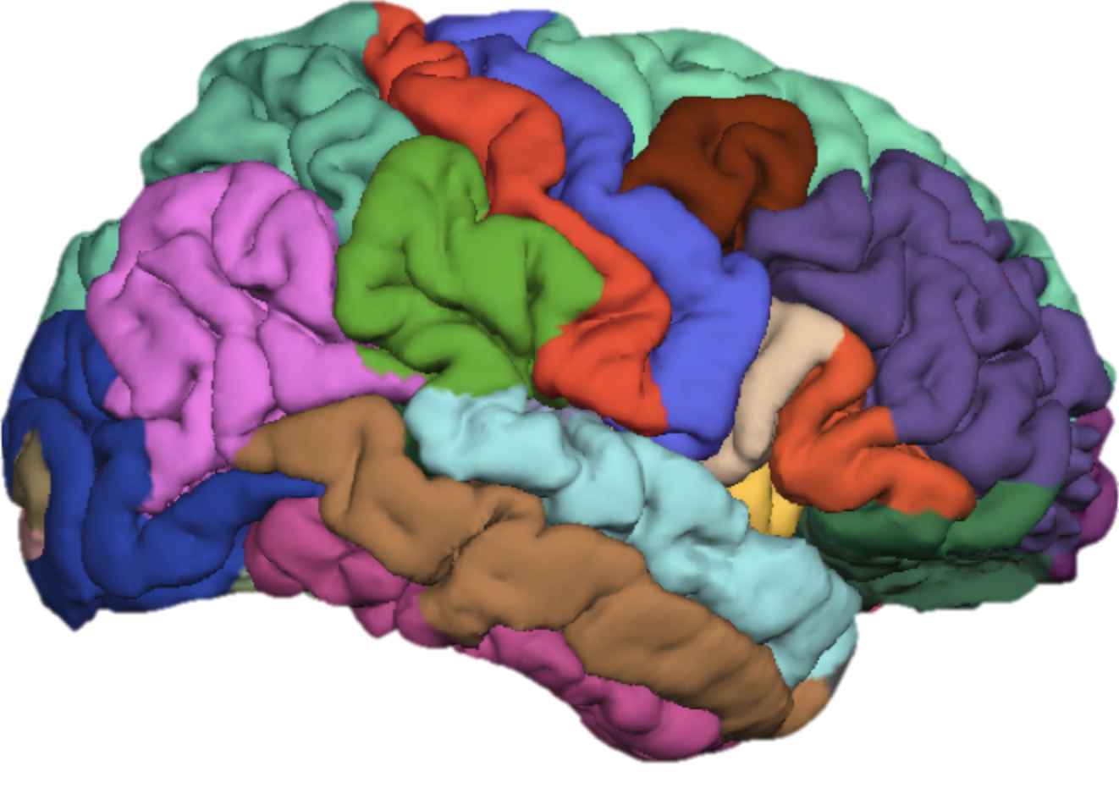
FreeSurfer Class 3: Segmenting the Brain (autorecon2)
Cat Camacho
1/30/17
11:00am-12:30pm

Slide 2
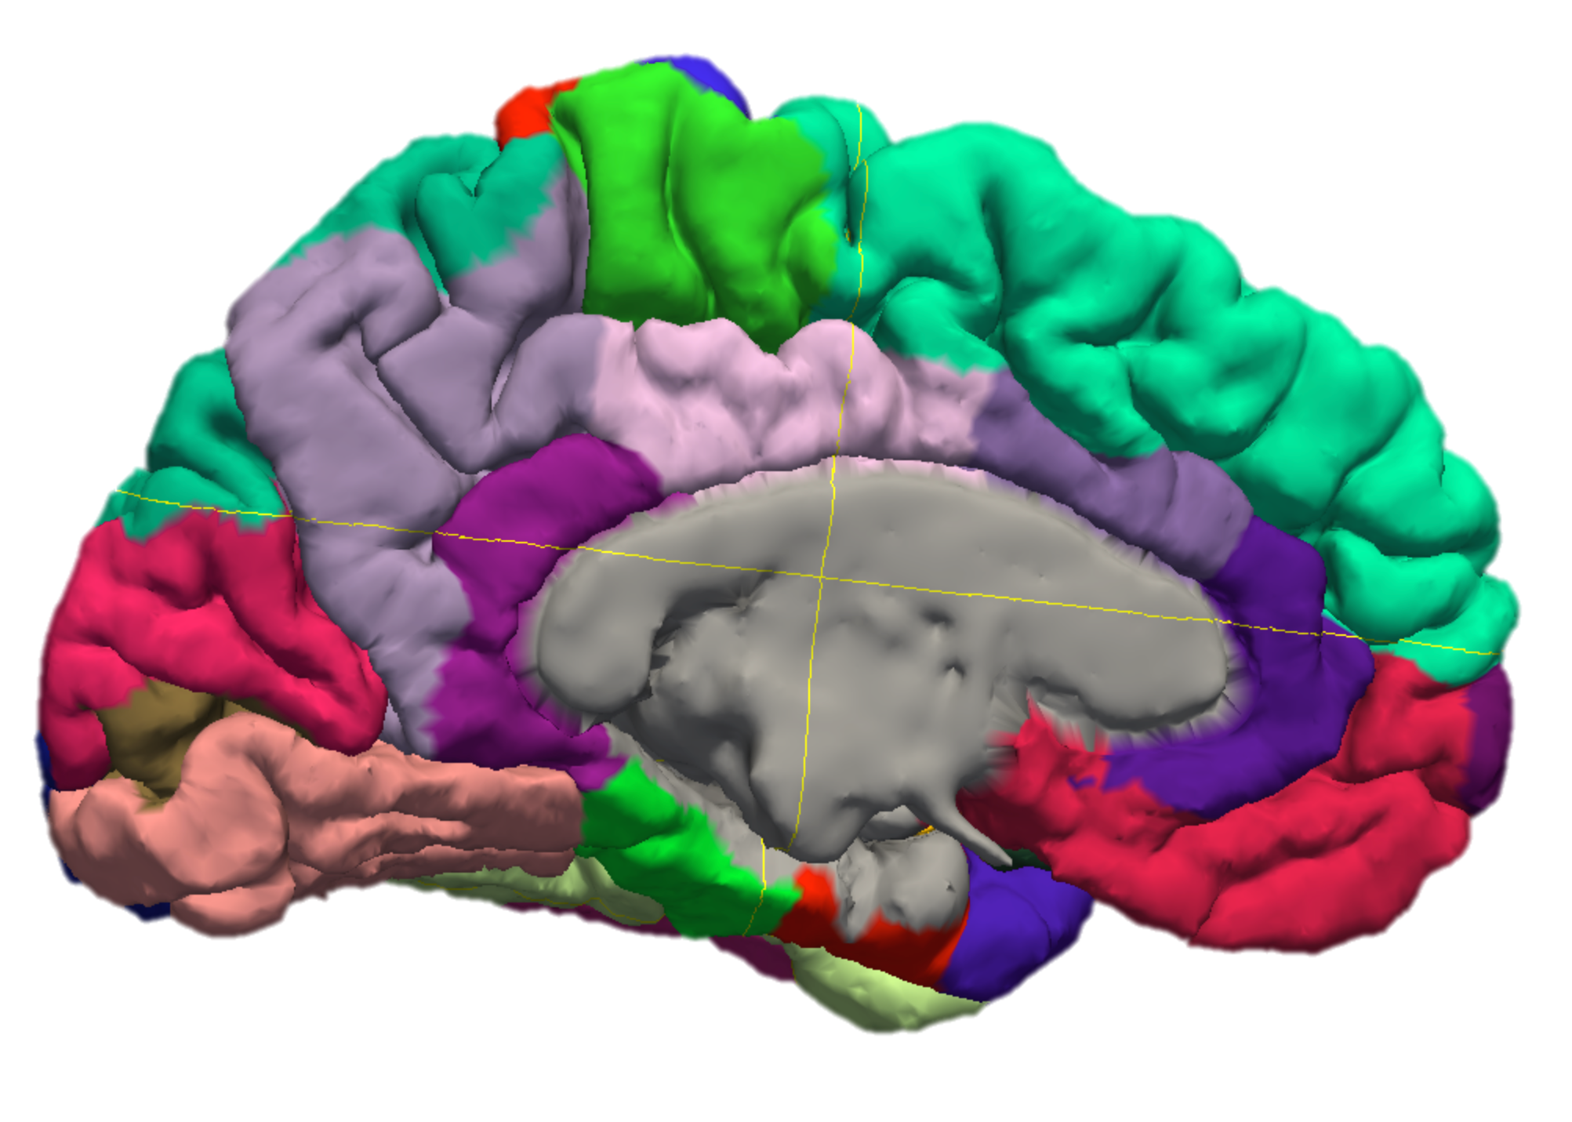
Goals for Today
Check in about brainmask editing and talairach registration
Go over outputs
FreeSurfer autorecon2
Automatic Segmentation
Freeview
Cortex/WM Surfaces

Slide 3
Subject Folder Contents
mri
brain.mgz: The final brain volume
aseg.mgz: whole brain segmentation
wm.mgz: white matter segmentation
surf
lh.pial/rh.pial
lh.white/rh.white
lh.inflated/rh.inflated

Slide 4
Autorecon2
1. GCA registration
2. Automatic Segmentation (aseg)
3. WM Segmentation
4. Fill and Tessellate
5. Generate Surfaces

Slide 5
autorecon2 only
To only run through autorecon2 (~6 hours):
T/CSH:
>> setenv SUBJECTS_DIR /home/catcam1/FS_Class/subjDir
>> recon-all -s Monica -i /home/catcam1/FS_Class/raw/Monica/Monica_T1w_1.nii.gz -autorecon1 -autorecon2
BASH:
>> export SUBJECTS_DIR=/home/catcam1/FS_Class/subjDir
>> recon-all -s Monica -i /home/catcam1/FS_Class/raw/Monica/Monica_T1w_1.nii.gz -autorecon1 -autorecon2
To re-run autorecon2 for an existing subject:
T/CSH:
>> setenv SUBJECTS_DIR /home/catcam1/FS_Class/subjDir
>> recon-all -s Monica -autorecon2
BASH:
>> export SUBJECTS_DIR=/home/catcam1/FS_Class/subjDir
>> recon-all -s Monica -autorecon2

Slide 6
Automatic Segmentation (aseg)

Slide 7
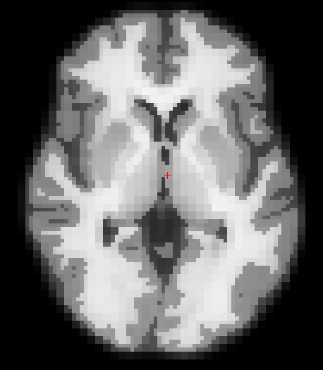
Gaussian Classifier Atlas
Atlas was created with probabilistic algorithms based on 12 manually labeled datasets
Validated on Alzheimer’s patients
ASEG Citation:
Fischl B, Salat DH, Busa E, et al. Whole Brain Segmentation: Automated Labeling of Neuroanatomical Structures in the Human Brain. Neuron. 2002;33(3):341-355. doi:10.1016/S0896-6273(02)00569-X.

Slide 8
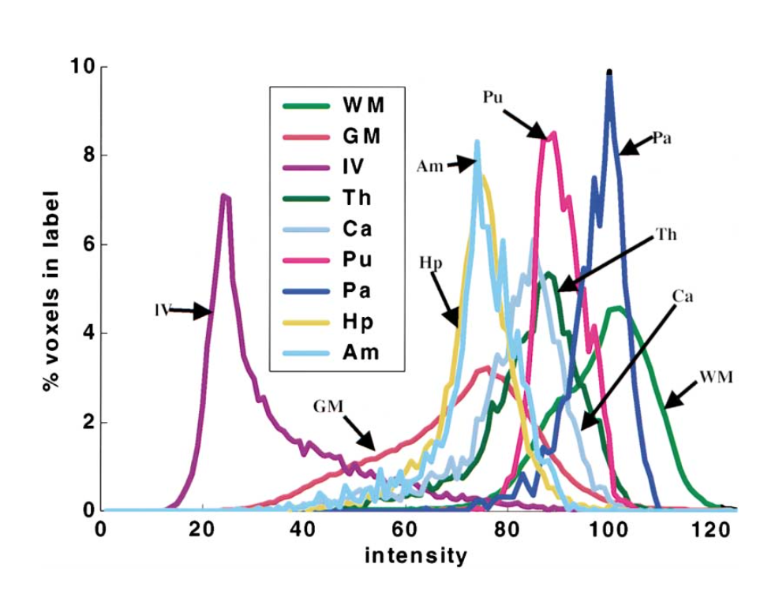
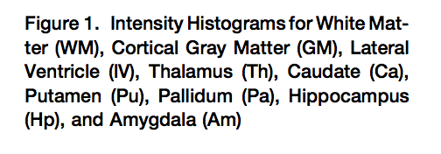
Why Intensity-based Atlases Don’t Work as Well
There is significant overlap in tissue intensities across the brain, even between WM and GM
(figure taken from Fischl 2002)

Slide 9
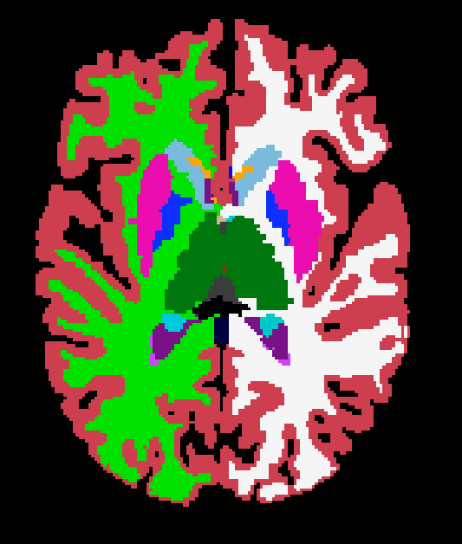
Automatic Segmentation
2 Segmentation Strategies:
Spatial: Transforms the GCA to subjects space
Intensity: local MRF probabilistic estimates
Labels are saved as integer values in aseg.mgz

Slide 10
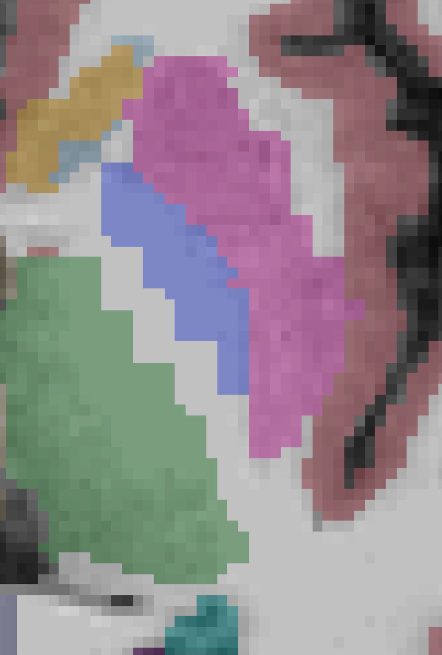
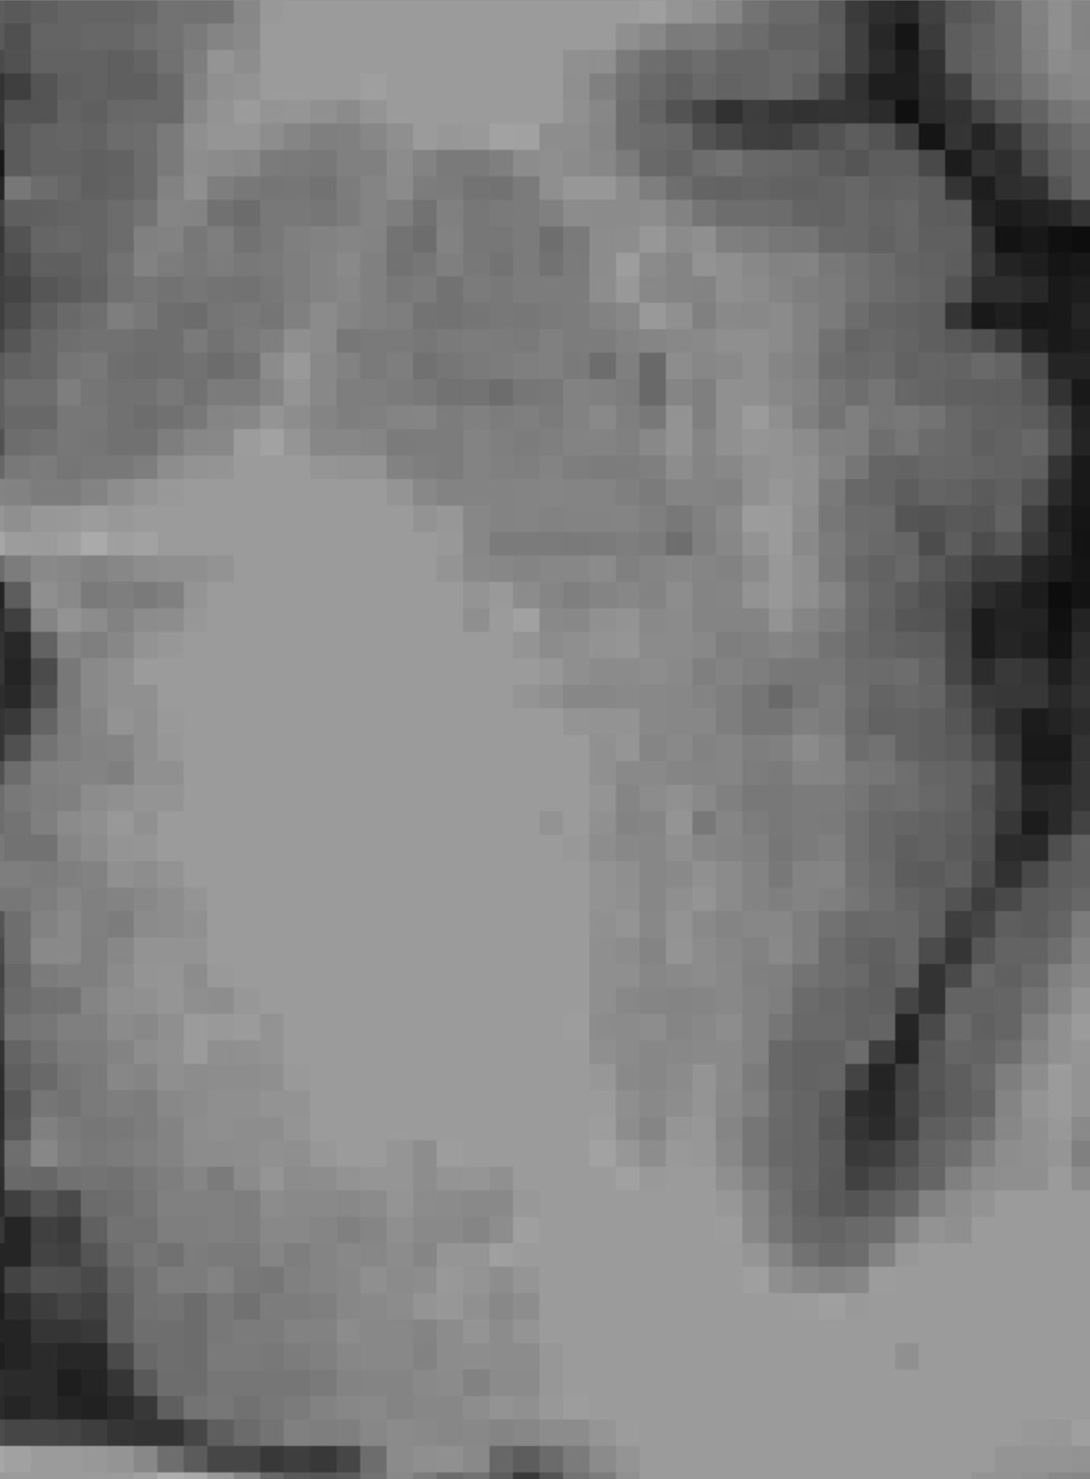
Trouble Areas
Pallidum & Thalamus
Putamen & Insula
The high fat content of these structures makes estimating the boundaries tricky
WM that separates the two is not always clear (usually due to partial volume effects from resampling)

Slide 11
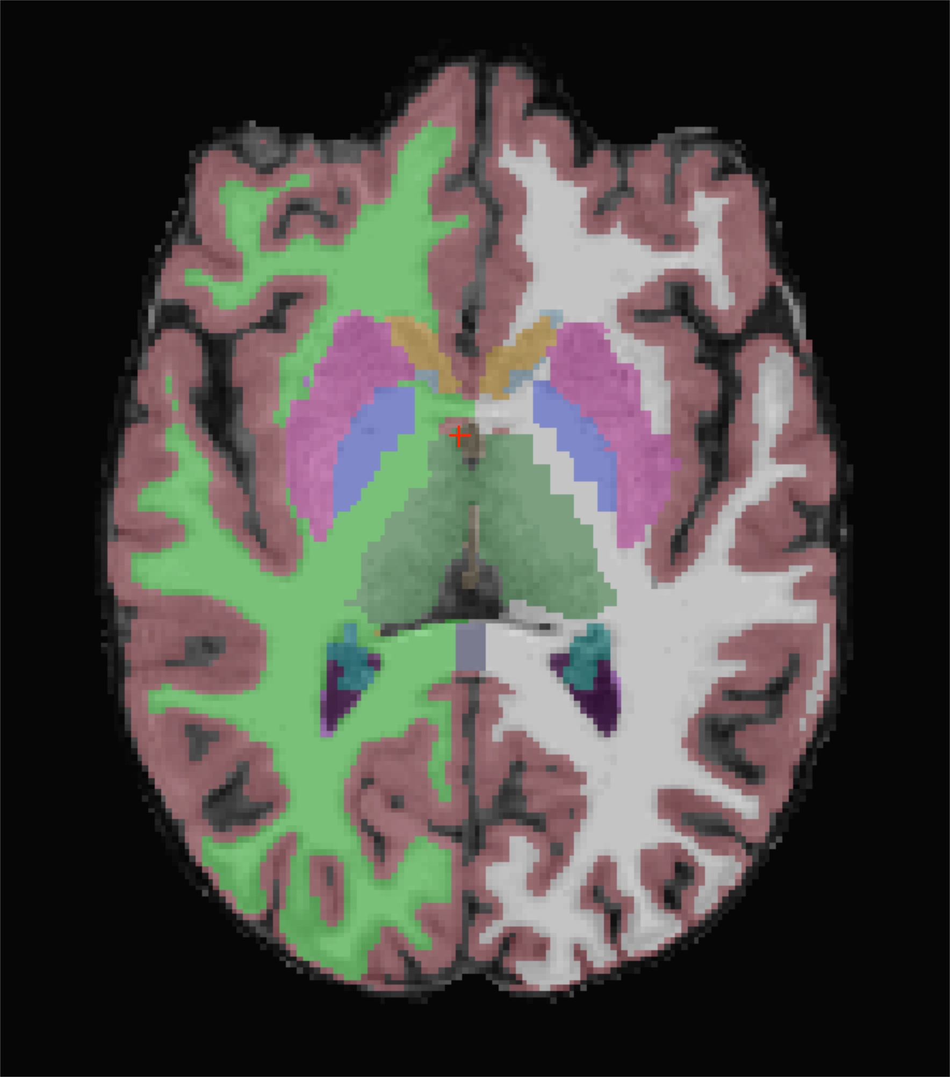
Checking Segmentation
Before extracting values, you want to check structures for accuracy
Look for:
Accuracy to the brainmask.mgz file
clear/unclear boundaries
consistency in quality across your sample
I recommend using Freeview

Slide 12
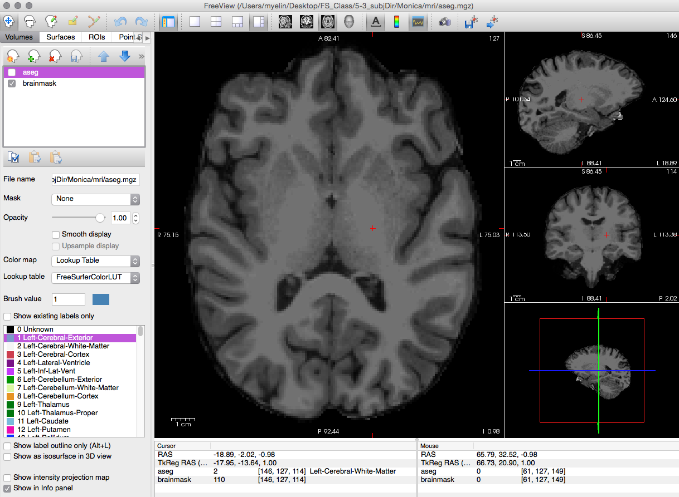
Freeview
To open freeview, type “freeview” into the Terminal:

Slide 13
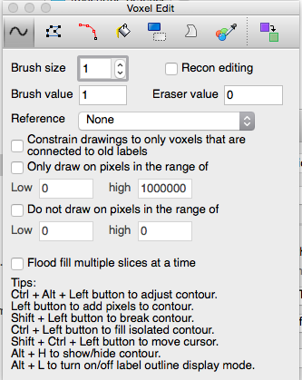
Fixing Segmentation
To edit segmentation, switch freeview to edit mode.
This opens the voxel editor window. From here, you can swap voxel values as needed.
Remember, if you manually edit 1 brain, you need to go through your whole sample.
Mouse/Keyboard shortcuts: https://surfer.nmr.mgh.harvard.edu/fswiki/FreeviewGuide/FreeviewReference/FreeviewMouseCommands

Slide 14
Automating Freeview Settings
To script your favorite freeview settings, there are Terminal commands:
Load specific volumes
Set view window main view and zoom factor
Set volume-specific lookup table
>> freeview -v $SUBJECTS_DIR/Monica/mri/brainmask.mgz -v $SUBJECTS_DIR/Monica/mri/aseg.mgz
>> freeview -viewport x -zoom 1.5
>> freeview -v $SUBJECTS_DIR/Monica/mri/aseg.mgz:lut=$SUBJECTS_DIR/bin/lut.txt
Type “freeview -h” into the terminal for more options

Slide 15
Cortical Surfaces

Slide 16
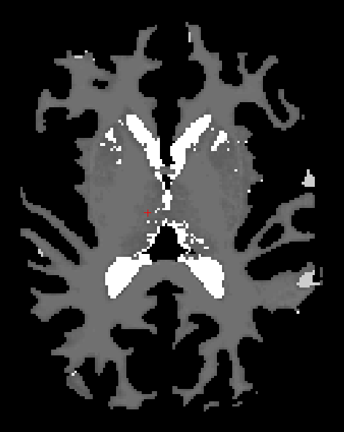
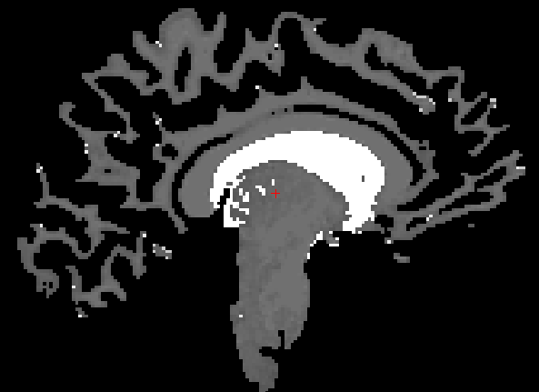
White Matter Segmentation
Using Aseg as well as control points from the talairach registration, freesurfer creates a segmentation of the white matter in the brain.

Slide 17
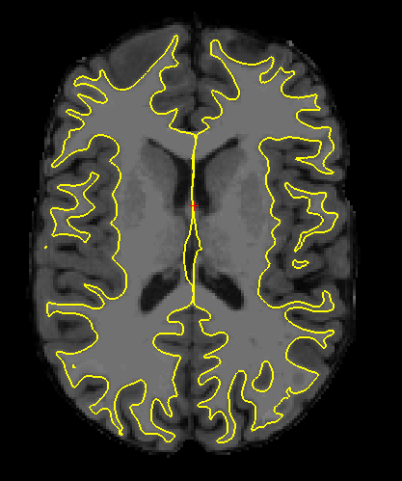
Creating a Cortex Map: WM fill, Tessellation, and Smoothing
WM Fill
Fills the white matter segmentation with triangles
Tessellation
creates a surface of triangles over the WM triangles
Smoothing
Removes the triangle edges creating a surface (see right)

Slide 18
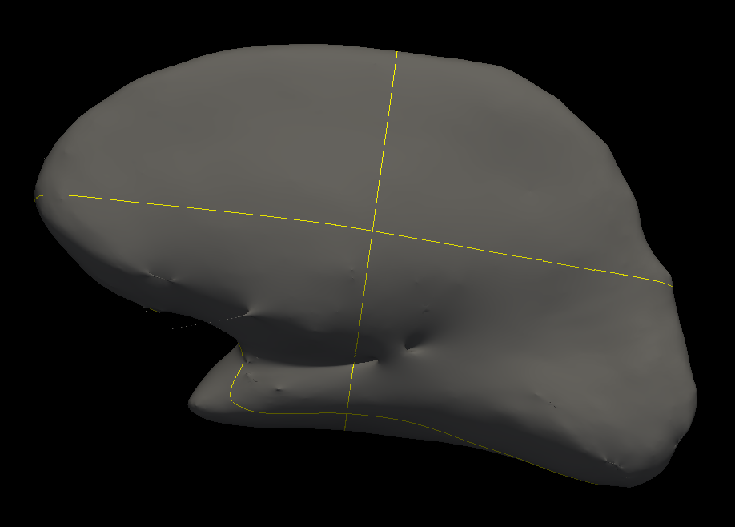
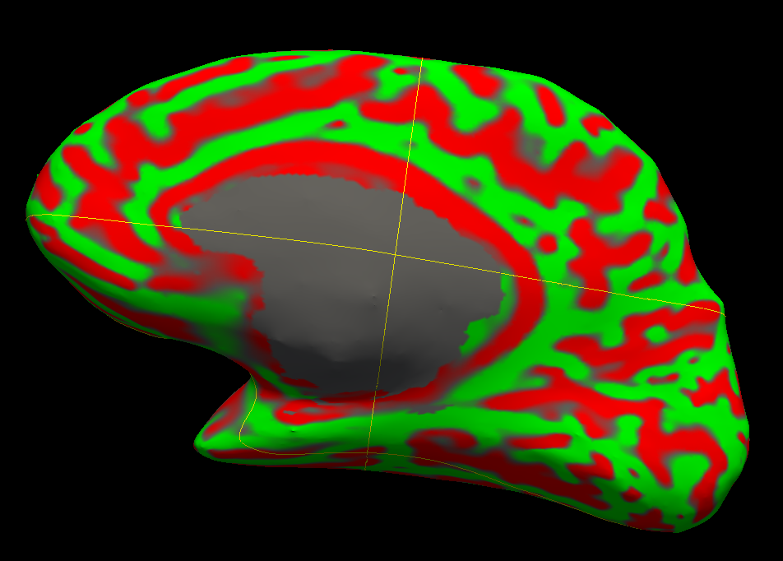
Creating a Cortex Map: Inflation and Topology Correction
Inflation
The smoothed surface is inflated and inspected for defects (lh.inflated.nofix)
Topology Correction
Errors in the surfaced are fixed using geometric inferences
*see Segonne, Pacheco & Fischl 2007 for more details

Slide 19
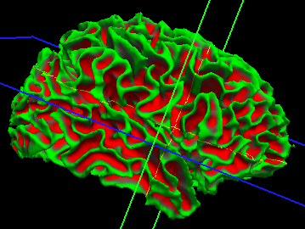
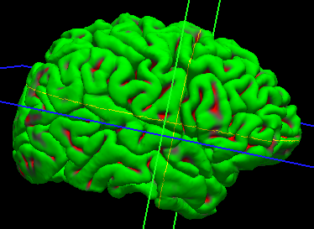
Creating a Cortex Map: Final Surfaces
Once the surfaces are corrected, they are fitted back onto the brain. The brain is now ready for parcellation!
Top-left: WM surface
bottom-left: Pial surface

Slide 20
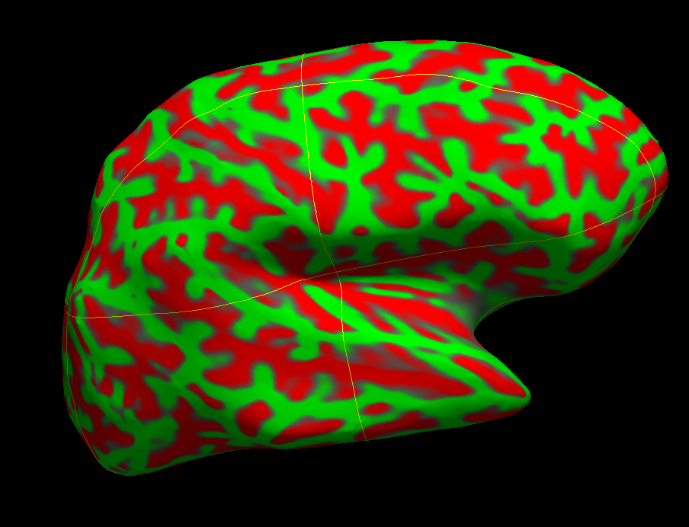
Inflated Surfaces

Slide 21
Surfaces Quality Assurance
If you are using cortical parcellation for ROIs in another analysis, you are probably set to run autorecon3 at this point
If you want to quantify and extract cortex anatomy, it is strongly recommended you manually correct the surfaces
For manual editing, we turn back to tkmedit

Slide 22
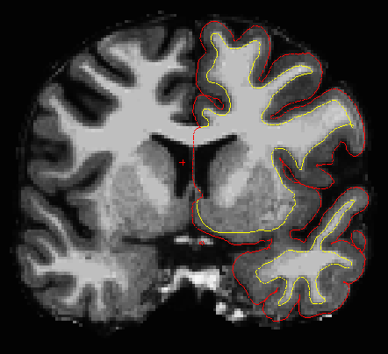
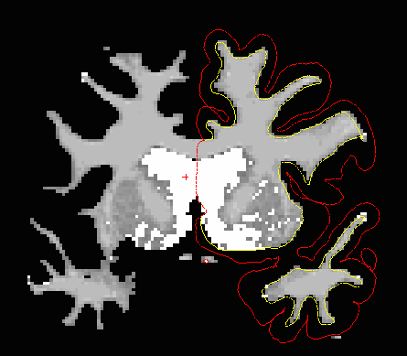
Editing the Pial and WM Surfaces: “Brain Tracing”
1. Open tkmedit with:
main- brainmask.mgz
aux- wm.mgz
surfaces- lh.pial, rh.pial, lh.white, rh.white
2. Set the brush to edit the WM volume
3. Make edits to the WM volume to move the WM surface boundary

Slide 23
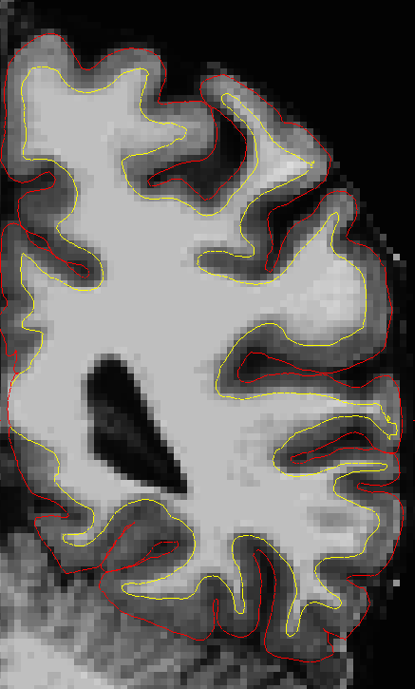
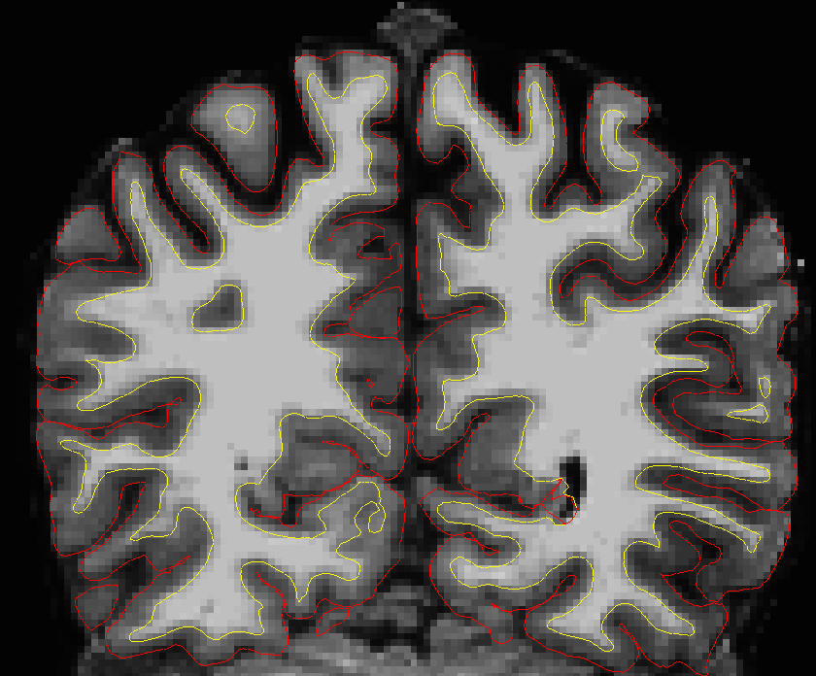
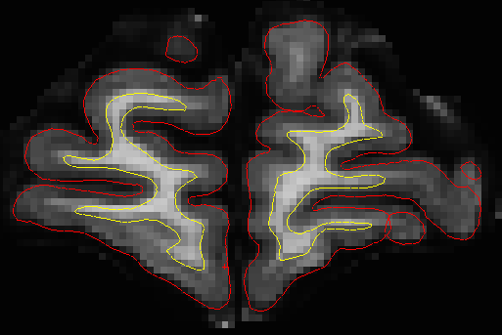
Problem Areas
Lara’s CIBSR certification covers these in greater detail:
Dura(when included in the pial surface)
Frontal pole
Temporal areas (near hippocampus and amygdala)
Any artifact areas (e.g. occipital lobe)
Medial cortex (e.g. cingulate)
With any of these regions, the goal is to add/subtract to the WM surface in order to correct the pial surface.

Slide 24
Automate TKMedit
Loading the volumes and surfaces
*This can also be found in the editWM script in the class bin
Applying edits (2-4 hours)
* This can also be found in the applyWMedits script in the class bin
>> tkmedit Monica brainmask.mgz lh.white -aux wm.mgz -aux-surface rh.white
>> recon-all -s Monica -autorecon2-cp

Slide 25
Recommended Practice
Write a script for freeview that:
opens the T1.mgz volume
opens the aseg.mgz volume with the class bin version of the look up table
opens in sagittal view (z) at a 1.5 zoom factor
Manually fix Monica’s putamen-white matter-insula boundaries
Manually clean Meghan’s occipital lobe cortical surfaces (don’t forget to apply your edits)

